Slide 1
LEO Constellation Diversity

Slide 2
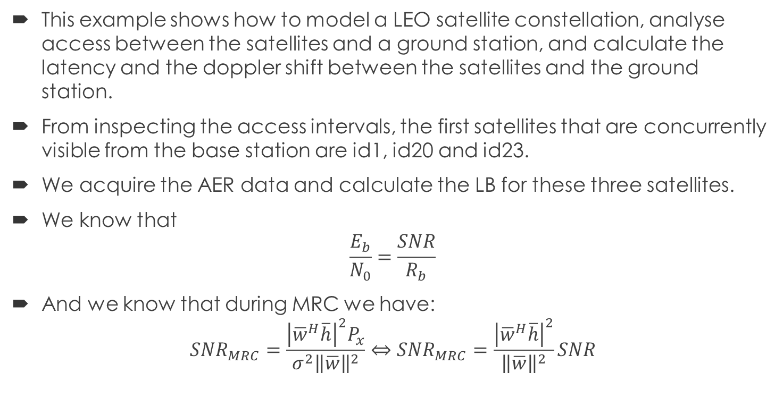
Scenario
This example shows how to model a LEO satellite constellation, analyse access between the satellites and a ground station, and calculate the latency and the doppler shift between the satellites and the ground station.
From inspecting the access intervals, the first satellites that are concurrently visible from the base station are id1, id20 and id23.
We acquire the AER data and calculate the LB for these three satellites.
We know that
$$\frac{E_{b}}{N_{0}}=\frac{SNR}{R_{b}}$$
And we know that during MRC we have:
$$SNR_{MRC}=\frac{{\left|{\overline{w}}^{H}\overline{h}\right|}^{2}P_{x}}{σ^{2}{\left\|\overline{w}\right\|}^{2}}⇔SNR_{MRC}=\frac{{\left|{\overline{w}}^{H}\overline{h}\right|}^{2}}{{\left\|\overline{w}\right\|}^{2}}SNR$$

Slide 3
Spatial Diversity in Satellites
Multiple Satellites or Antennas
Combat fading or blockage
Improve signal reliability
Reduce outages
Image a city with skyscrapers and trees blocking satellite signals. A user may temporarily lose signal from one satellite, but others may still be visible.
Setup:
Receiver on the Ground
3 LEO satellites with different trajectories
Each has different elevation angle and signal strength → Randomly affected paths

Slide 4
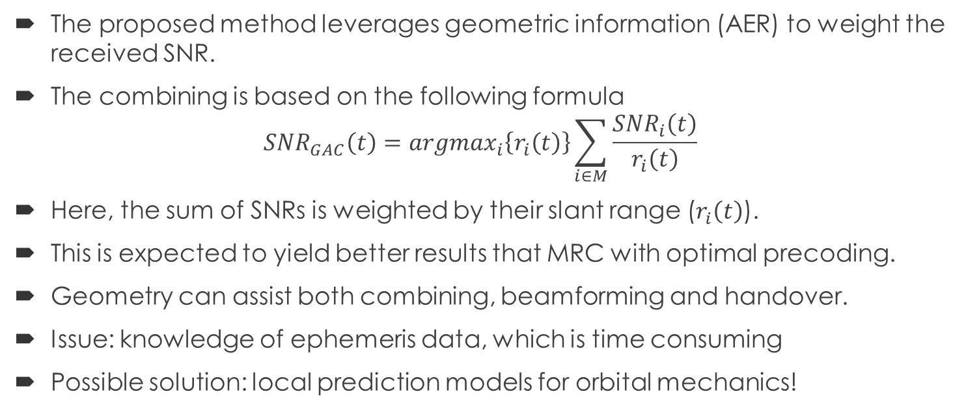
Geometry-Assisted Combining (GAC)
The proposed method leverages geometric information (AER) to weight the received SNR.
The combining is based on the following formula
$$SNR_{GAC}\left(t\right)=argmax_{i}\left\{r_{i}\left(t\right)\right\}\sum_{i∈M}{\frac{SNR_{i}\left(t\right)}{r_{i}\left(t\right)}}$$
Here, the sum of SNRs is weighted by their slant range ($r_{i}\left(t\right)$).
This is expected to yield better results that MRC with optimal precoding.
Geometry can assist both combining, beamforming and handover.
Issue: knowledge of ephemeris data, which is time consuming
Possible solution: local prediction models for orbital mechanics!

Slide 5
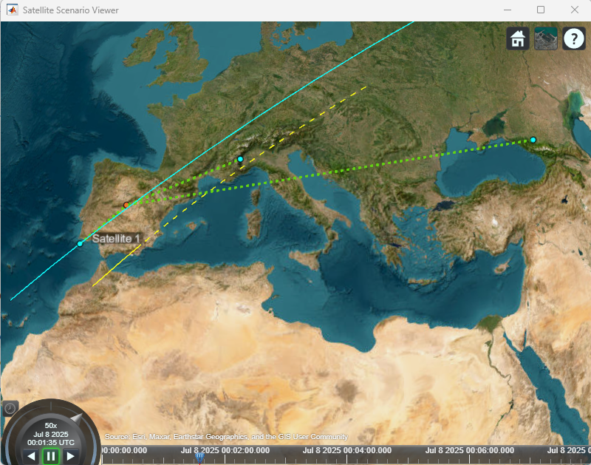
Scenario Viewer
We can see that there exists a link to all three satellites.
This examples inspects the single link, uplink or downlink, if the system model stops at the satellite.
Satellite 1 is the closest to the BS.
Satellite 23 is the second closest.
Satellite 20 is the first to go out of sight.
All satellites remain in view for about 2 minutes. Then we have two satellites.

Slide 6
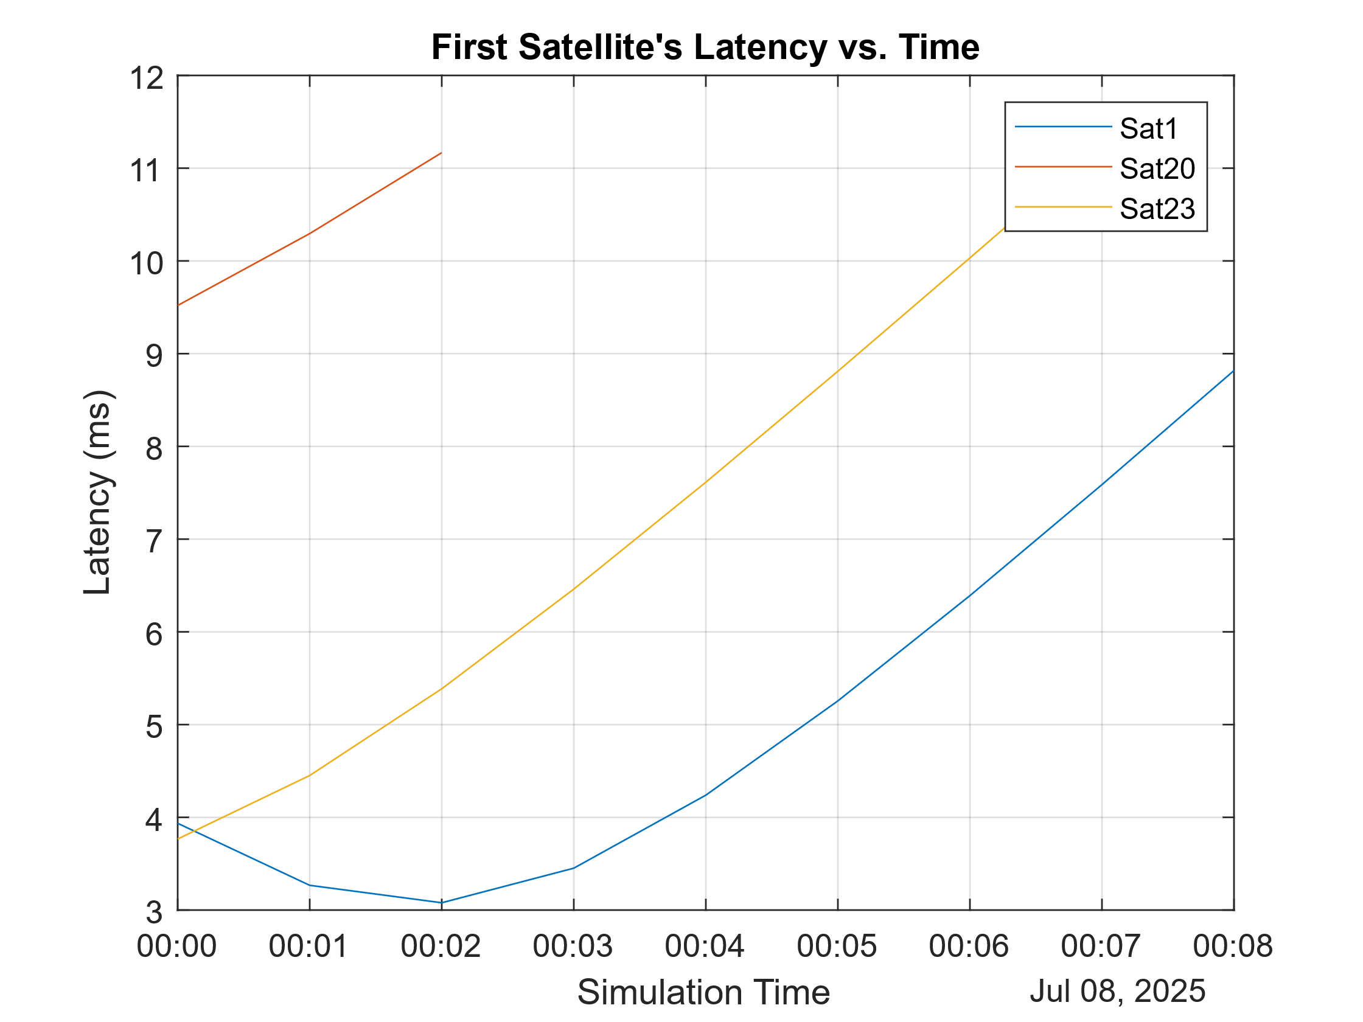
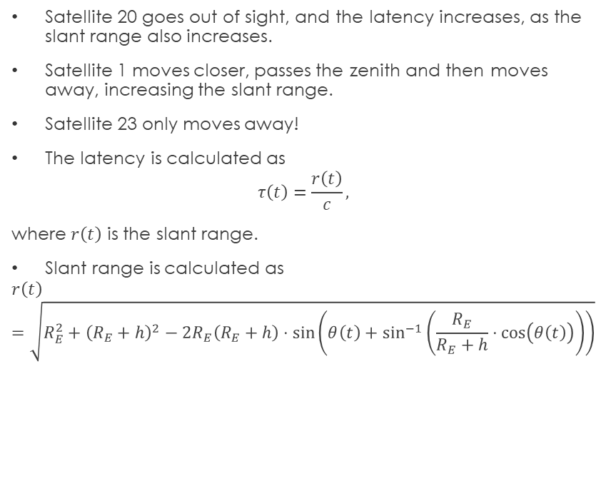
Latency
Satellite 20 goes out of sight, and the latency increases, as the slant range also increases.
Satellite 1 moves closer, passes the zenith and then moves away, increasing the slant range.
Satellite 23 only moves away!
The latency is calculated as
$$τ\left(t\right)=\frac{r\left(t\right)}{c},$$
where $r\left(t\right)$ is the slant range.
Slant range is calculated as
$$r\left(t\right)=\sqrt{R_{E}^{2}+{\left(R_{E}+h\right)}^{2}−2R_{E}\left(R_{E}+h\right)⋅\sin\left(θ\left(t\right)+\sin^{−1}\left(\frac{R_{E}}{R_{E}+h}⋅\cos\left(θ\left(t\right)\right)\right)\right)}$$

Slide 7
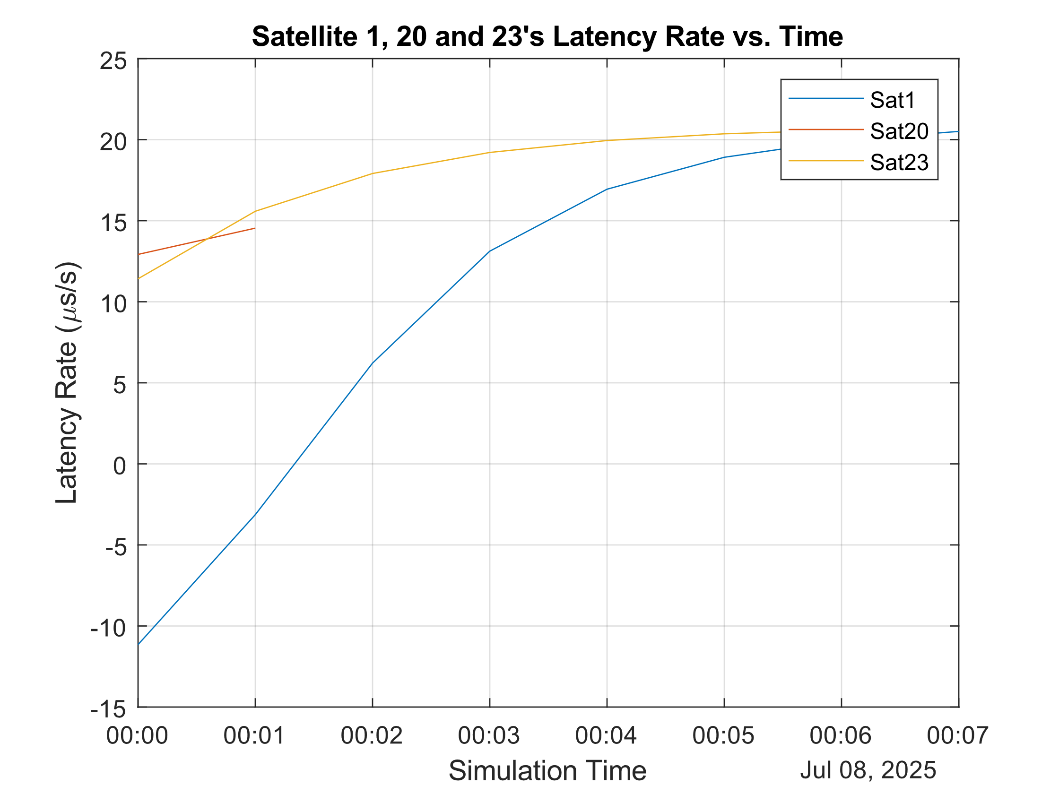
Latency Rate
Latency rate displays the behavior of the satellite.
All rates are increasing, meaning the latency becomes bigger.
Satellite 1 displays negative latency rates, due to the initial decrease in latency.

Slide 8
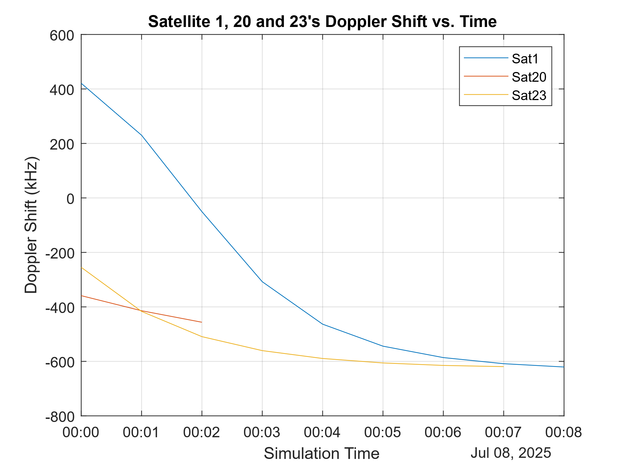
Doppler Shift
LEO satellites move with speed approximately 7 km/sec.
LEO satellites display huge doppler shifts, due to high-speed motion.
Sat1 displays positive doppler because it moves towards the BS, then 0 at the zenith and then negative due to moving away.
Other satellites display negative doppler since moving away.

Slide 9
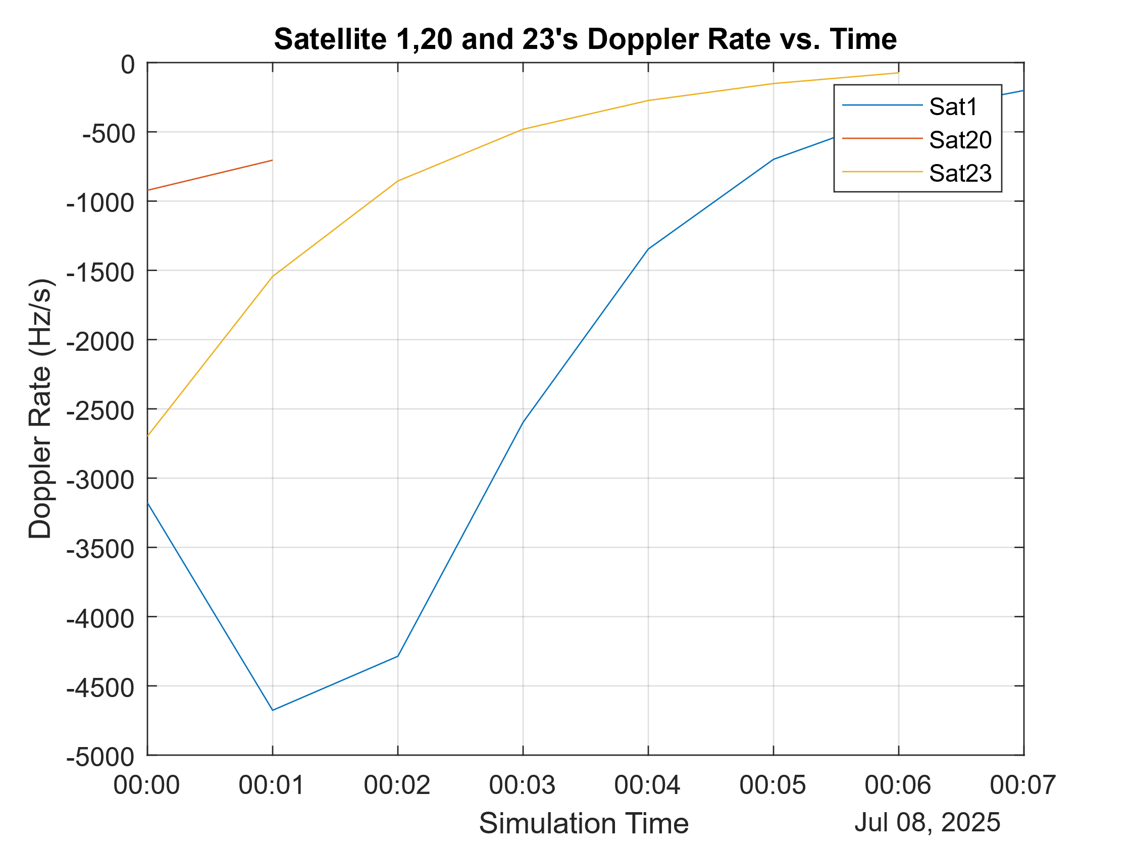
Doppler Shift Rate
How quickly the observed frequency of a wave changes due to the relative motion between the source and the observer
DSR helps take decisions, since we know the time frame where the frequency shift may be relatively stable.

Slide 10
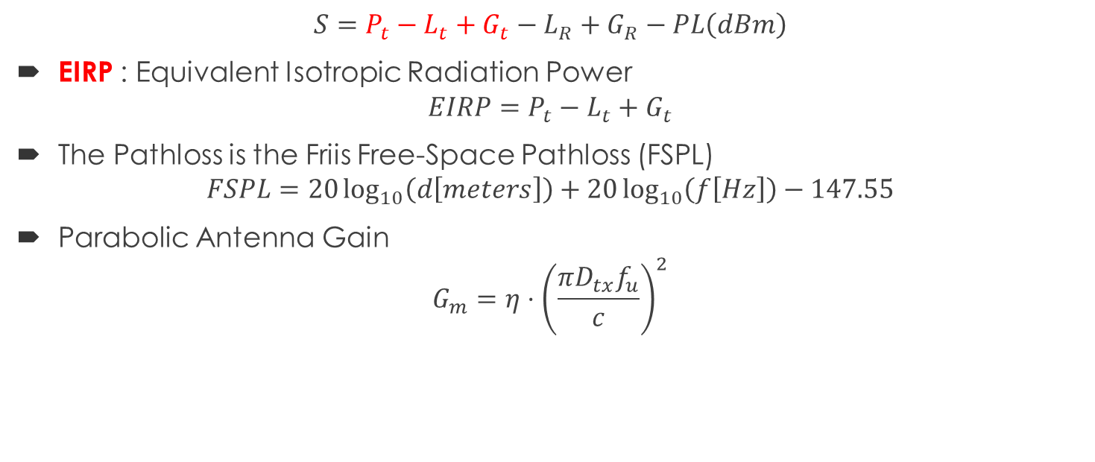
Link Budget Calculation
$$S=P_{t}−L_{t}+G_{t}−L_{R}+G_{R}−PL\left(dBm\right)$$
EIRP : Equivalent Isotropic Radiation Power
$$EIRP=P_{t}−L_{t}+G_{t}$$
The Pathloss is the Friis Free-Space Pathloss (FSPL)
$$FSPL=20\log_{10}\left(d\left[meters\right]\right)+20\log_{10}\left(f\left[Hz\right]\right)−147.55$$
Parabolic Antenna Gain
$$G_{m}=η⋅{\left(\frac{πD_{tx}f_{u}}{c}\right)}^{2}$$

Slide 11
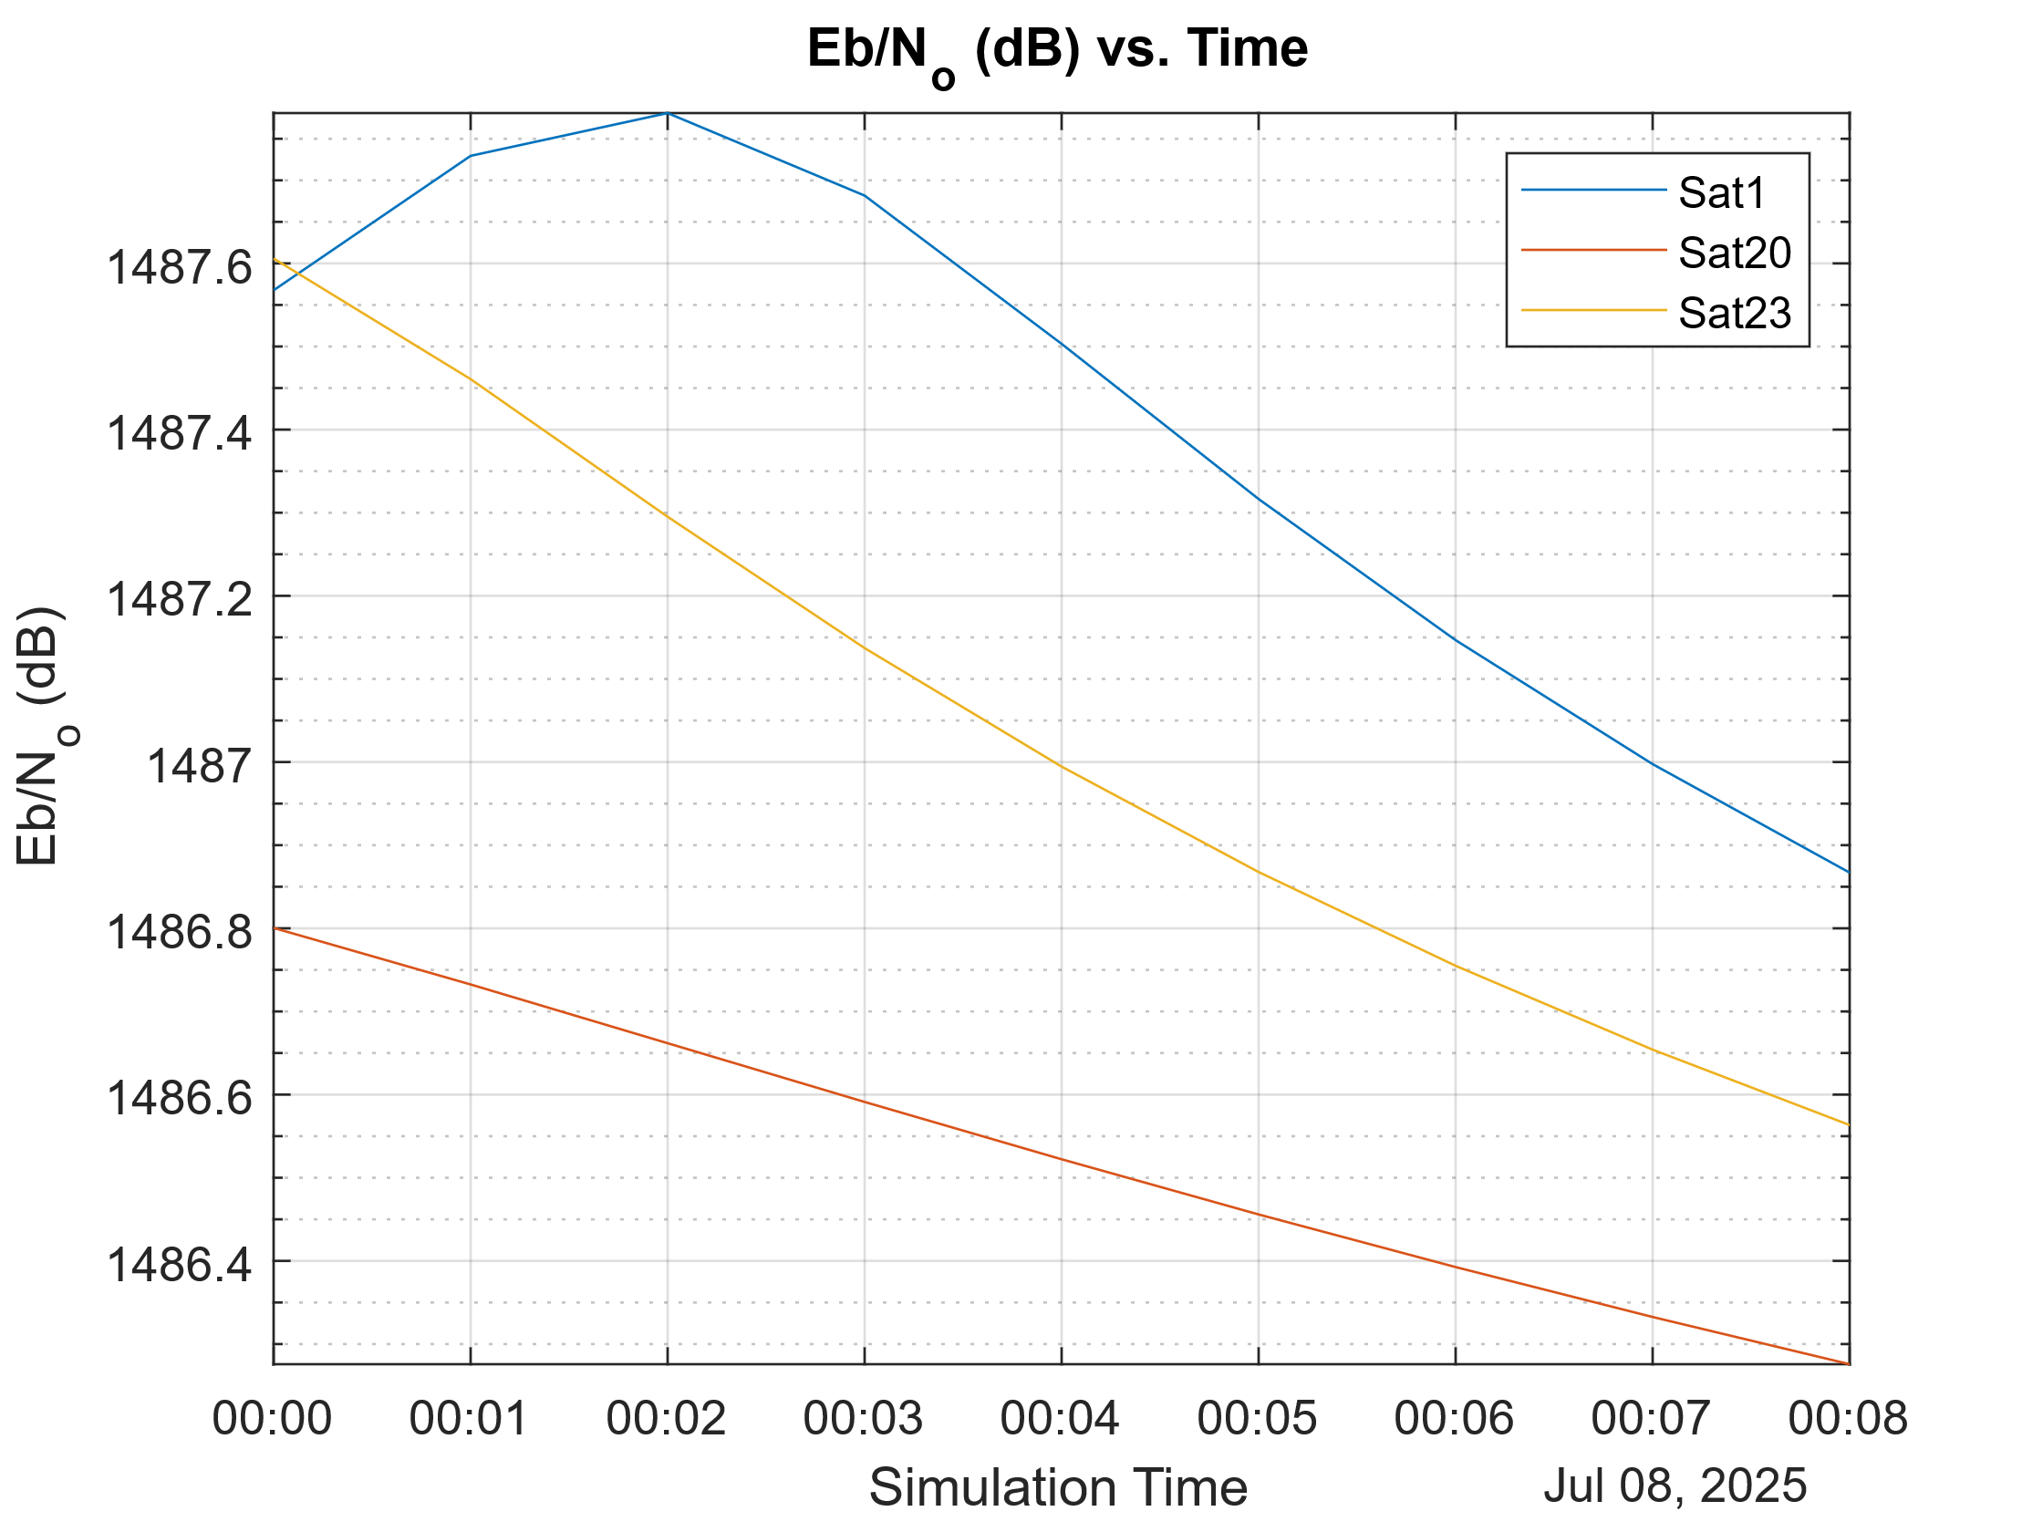
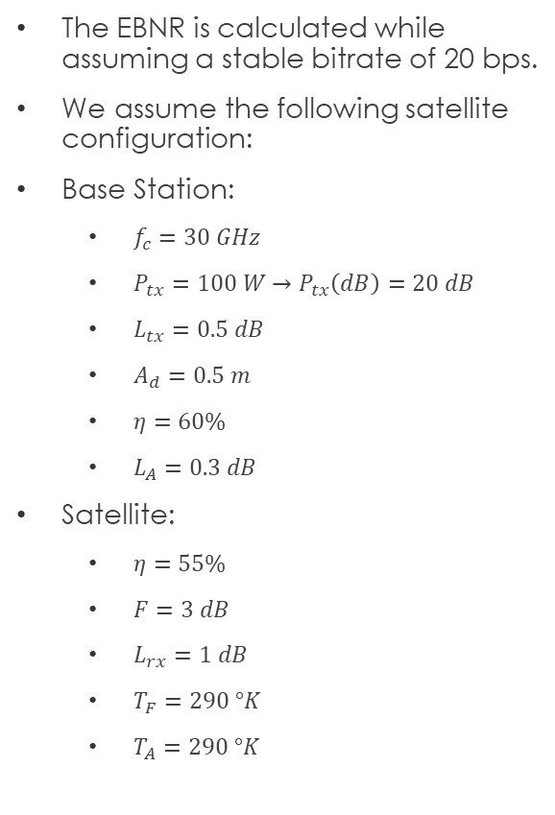
Bit Energy To Noise Density Ratio (EBNR)
The EBNR is calculated while assuming a stable bitrate of 20 bps.
We assume the following satellite configuration:
Base Station:
$f_{c}=30 GHz$
$P_{tx}=100 W→P_{tx}\left(dB\right)=20 dB$
$L_{tx}=0.5 dB$
$A_{d}=0.5 m$
$η=60\%$
$L_{A}=0.3 dB$
Satellite:
$η=55\%$
$F=3 dB$
$L_{rx}=1 dB$
$T_{F}=290 °K$
$T_{A}=290 °K$

Slide 12
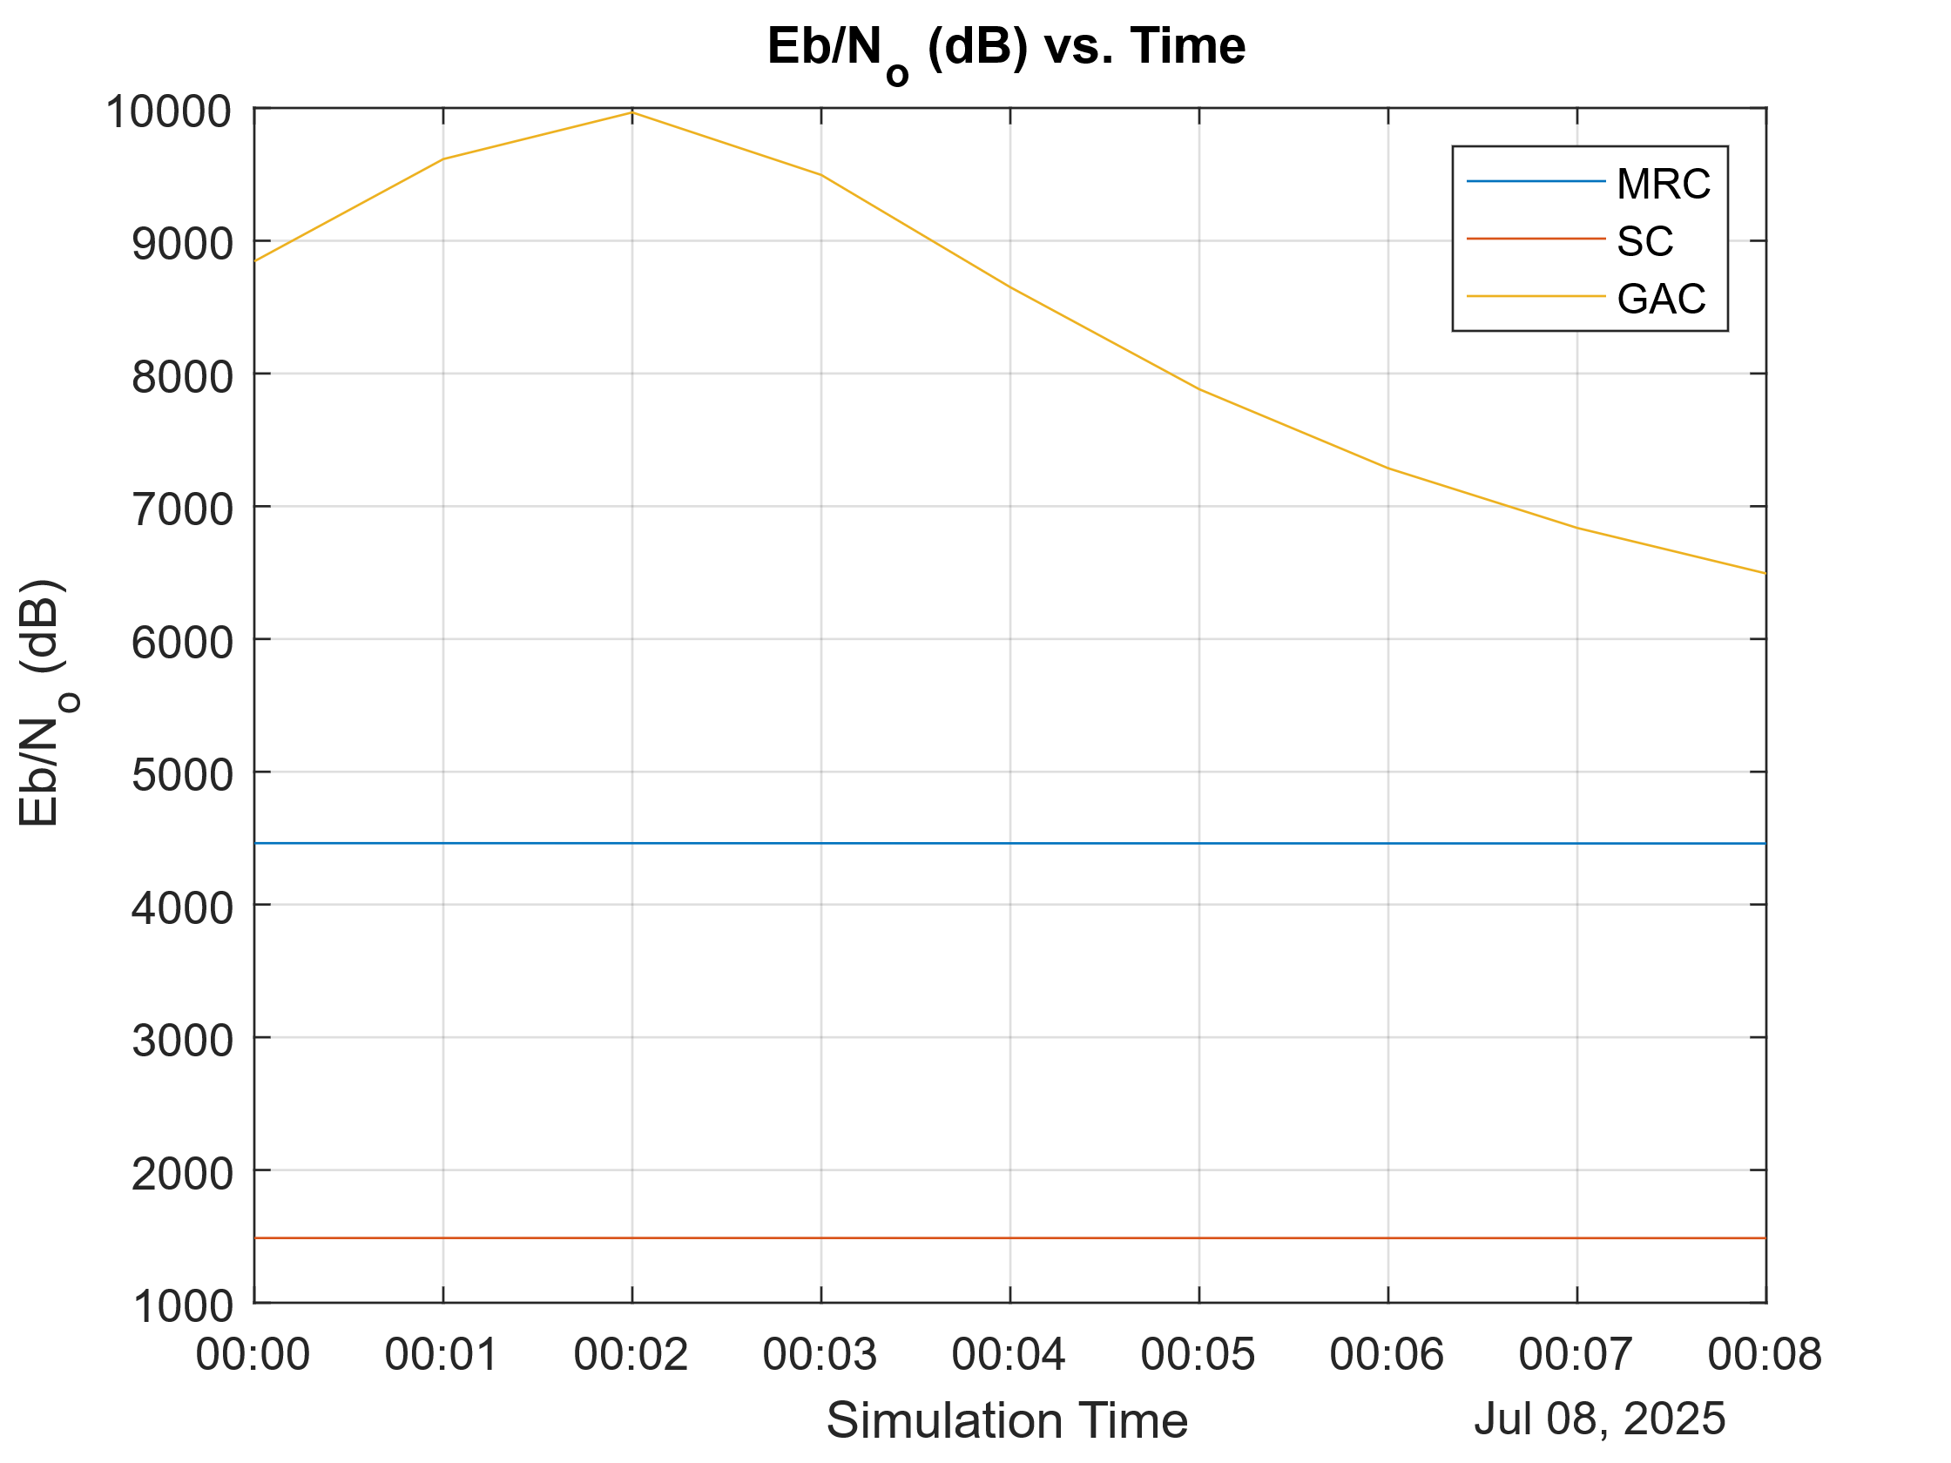
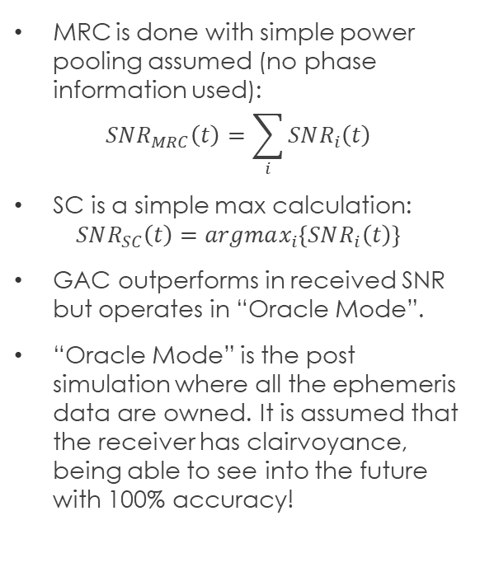
Comparison of MRC, SC and GAC
MRC is done with simple power pooling assumed (no phase information used):
$$SNR_{MRC}\left(t\right)=\sum_{i}{SNR_{i}\left(t\right)}$$
SC is a simple max calculation:
$$SNR_{SC}\left(t\right)=argmax_{i}\left\{SNR_{i}\left(t\right)\right\}$$
GAC outperforms in received SNR but operates in “Oracle Mode”.
“Oracle Mode” is the post simulation where all the ephemeris data are owned. It is assumed that the receiver has clairvoyance, being able to see into the future with 100% accuracy!

Slide 13
Open issues
BER and Outage need to be extended.
Phased MRC must be compared
Power pool is too simplistic and does not include phase information
Must construct the channel coefficient, while the Satellite toolbox does not provide any channel characteristics, besides E_{b}/N₀, delay and latency calculations.
Combination of simulation6 and simulation7
This is the “Oracle Mode” where the whole future ephemeris data is known, post simulation. But the real-time system needs a prediction model.
The prediction model calculates the slant ranges and applies GAC using predicted values.

Slide 14
Possible Prediction Methods
Kalman Filter 1D
Linear Regression with historical shift buffer
Reinforcement Learning (harder)
Pre-trained Neural Network on Ephemeris Data (TLE, SGP4)
We will choose the simpler one for this thesis, while attempting all of them. Future work will contain each of the methods that were not selected.

